Slide 1
C++ Value Categories
Levon Prazyan Nov 2024

Slide 2
Agenda
Historical overview.
Value Categories Since c++11
Value Categories Since c++17
Special Rules for Value Categories.
Value Categories and Binding References.
Lvalue Becomes Rvalue.
Rvalue Becomes Lvalue.
Value Categories and decltype

Slide 3
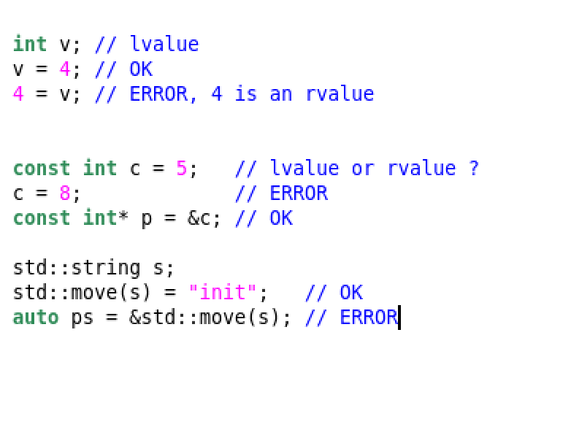
Historical Overview
Value Category | K&R C | ANSI-C | C++98
lvalue | left-hand side of an assignment | locator value | locator value
rvalue | right-hand side of an assignment | readable value | readable value

Slide 4
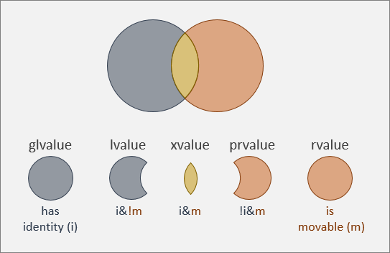
Value Categories Since c++11
Value Category | C++11
lvalue | locator value
prvalue | pure readable value
xvalue | expiring value
glvalue | generalized lvalue
rvalue | xvalue or prvalue

Slide 5
Value Categories Since c++11 (2)
lvalue examples
prvalue examples
xvalue examples
Name of a variable
String literal
Return value of a function declared to return a lvlue &
Any reference to a function
The result of the built-in unary * operator
Built-in literal
Return type of a function declared to return by value
Result of the built-in unary & operator
Lambda expression
The result of marking object with std::move
A cast to a Type&& of an object type
The return value of a function declared to return Type&&
A non-static value member of a rvalue

Slide 6
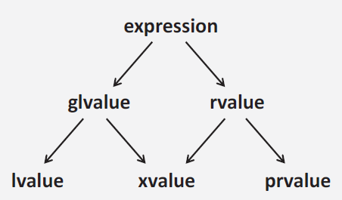
Value Categories Since c++11 (3)
All names used as expression are lvalues.
All string literals are lvalues.
All non-string literals are prvalues.
All temporaries without a name are prvalues.
All objects marked with std::move (including their value members) are xvalues.

Slide 7
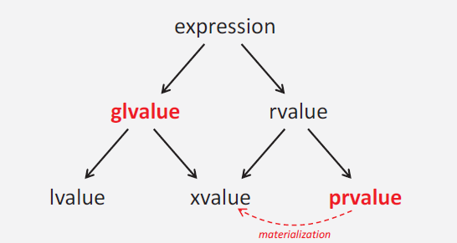
Value Categories Since c++17
glvalues: expressions for locations of long-living objects or functions.
prvalues: expressions for short living values for initializations.
xvalues: expressions representing a long-living object whose values are no longer needed.
Temporary materialization conversion is a prvalue to xvalue conversion.

Slide 8
Special Rules for Value Categories
All expressions that are references to functions are lvalues.
void (&&ref)() = f; // ref is a lvalue
Data members
Data members of lvalues are lvalues.
Reference and static data members of rvalues are lvalues
Plain data members of rvalues are xvalues.
std::move(obj).member vs std::move(obj.member)

Slide 9
Value Categories and Binding References
Call | f(X&) | f(const X&) | f(X&&) | f(const X&&)
f(v) | 1 | 2 | - | -
f(c) | - | 1 | - | -
f(X{}) | - | 3 | 1 | 2
f(std::move(v)) | - | 3 | 1 | 2
f(std::move(c)) | - | 2 | - | 1
Universal references are not included in this table.

Slide 10
Value Categories and Binding References
Call | f(X&) | f(const X&) | f(X&&) | f(const X&&)
f(v) | 1 | 2 | - | -
f(c) | - | 1 | - | -
f(X{}) | - | 3 | 1 | 2
f(std::move(v)) | - | 3 | 1 | 2
f(std::move(c)) | - | 2 | - | 1
Call | f(X&) | f(const X&) | f(X&&) | f(const X&&) | template <typename T> f(T&&)
f(v) | 1 | 3 | - | - | 2
f(c) | - | 1 | - | - | 2
f(X{}) | - | 4 | 1 | 3 | 2
f(std::move(v)) | - | 4 | 1 | 3 | 2
f(std::move(c)) | - | 3 | - | 1 | 2

Slide 11
Value Categories and Binding References
class X {};
template<typename T>
void f(T&& arg)
{ /*…*/ }
X v;
const X c;
f(v);
f(c);
f(X{});
f(std::move(v));
f(std::move(c));
Call | T | arg
f(v) | X& | X&
f(c) | const X& | const X&
f(X{}) | X | X&&
f(std::move(v)) | X | X&&
f(std::move(c)) | const X | const X&&

Slide 12
Value Categories and Binding References, Lvalue Becomes Rvalue, Rvalue Becomes Lvalue, Value Categories and decltype covered by examples

Slide 13
Thank You

